Slide 1
The E-R Model

Slide 2
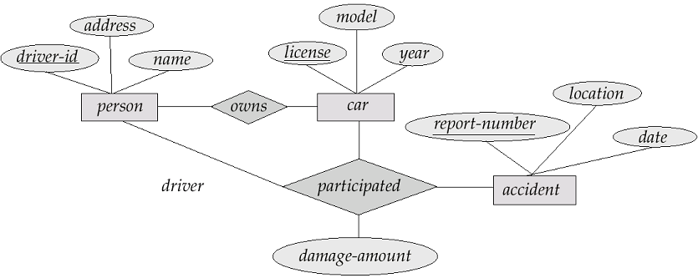

Slide 3
The E-R Model
The Entity-Relationship Model
  The E-R (entity-relationship) data model views the real world as a set of basic objects (entities) and relationships among these objects.
  It is intended primarily for the DB design process by allowing the specification of an enterprise scheme. This represents the overall logical structure of the DB.

Slide 4
Entities and Entity Sets
An entity is an object that exists and is distinguishable from other objects. For instance, Michelle Lee with S.S.N. 890-12-3456 is an entity, as she can be uniquely identified as one particular person in the universe.
An entity may be concrete (a person or a book, for example) or abstract (like a holiday or a disease or a concept).
An entity set is a set of entities of the same type (e.g., all persons having an account at a bank).
Entity sets need not be disjoint. For example, the entity set Student (all students in a university) and the entity set professor (all professors in a university) may have members in common. (i.e a computer science professor might take a class in anthropology).

Slide 5
Entities and Entity Sets Continued
An entity is represented by a set of attributes. (e.g. name, SSN, Phone-Num for “customer” entity.)
The domain of the attribute is the set of permitted values (e.g. the telephone number must be seven positive integers).
Formally, an attribute is a function which maps an entity set into a domain.
Every entity is described by a set of (attribute, data value) pairs. There is one pair for each attribute of the entity set.
e.g. a particular student entity is described by the set {(name, Lee), (SSN, 890-123-456), (street, Blaine), (city, Riverside)}.

Slide 6
E-R diagrams
We can express the overall logical structure of a database graphically with an E-R diagram.
Its components are:
  rectangles representing entity sets.
  ellipses representing attributes.
  diamonds representing relationship sets.
  lines linking attributes to entity sets and entity sets to relationship sets.
S.S.N
Street
name
City
Students
Note that this is a poor example of a entity, since the name is represented as one attribute and there is no street number attribute.
We will consider the problem of designing good entities later, here we are just concerned with explaining their graphical representation.
Also note that one of the attributes is underlined, we will explain why later.

Slide 7
E-R diagrams Continued
We can express the overall logical structure of a database graphically with an E-R diagram.
Its components are:
  rectangles representing entity sets.
  ellipses representing attributes.
  diamonds representing relationship sets.
  lines linking attributes to entity sets and entity sets to relationship sets.
The “since” attribute in this example is called a descriptive attribute, since it describes the mapping from A to B
S.S.N
Street
since
name
P.I.D
name
City
Students
advised
by
Professor

Slide 8
How to represent Constraints
Hugely important:
The constraints are given to us from the application
Two main kinds of constraints:
Key (or cardinality) constraints
Participation constraints

Slide 9
Key Constraints
We can also use arrows to indicate key constraints (often simply referred to as Cardinality Constraints)
Suppose the university has the following rule: A professor is allowed to advise at most one student. However two or more professors are allowed to advise the same student.
This is an example of a one-to-many constraints, that is one student can be advised by many professors. We can represent this with an arrow as shown below.
S.S.N
Street
since
name
P.I.D
name
City
Students
advised
by
Professor

Slide 10
Key Constraints Continued
There are four possible key constraints, they express the number of entities to which another entity can be associated via a relationship. For binary relationship sets between entity sets A and B, the mapping cardinality must be one of:
One-to-one: An entity in A is associated with at most one entity in B, and an entity in B is associated with at most one entity in A.
One-to-many: An entity in A is associated with any number in B. An entity in B is associated with at most one entity in A.
Many-to-one: An entity in A is associated with at most one entity in B. An entity in B is associated with any number in A.
Many-to-many: Entities in A and B are associated with any number from each other.
The appropriate key constraint for a particular relationship set depends on the real world being modeled.

Slide 11




Key Constraints: Examples
One-to-one: An entity in A is associated with at most one entity in B, and an entity in B is associated with at most one entity in A.
Assume this holds: A professor is assigned to at most one parking spot, and each parking spot may be assigned to at most one professor. Note that some faculty do not need parking space (they walk/bike to school) and some parking spaces may be unassigned.
PS1
PS4
since
name
name
PS3
Professors
Assigned
Parking-Spaces
Assigned
PS2
This diagram is not a part of the ER model! It is just an intuitive picture to explain a concept

Slide 12







Key Constraints: Examples
One-to-many: An entity in A is associated with any number in B. An entity in B is associated with at most one entity in A.
Assume this holds: A woman may be the mother of many (or no) children. A person may have at most one mother.
name
Born on
name
Is
Mother
of
Women's Club
Low I.Q. Club
Is mother of
Note that this example is not saying that Moe does not have a mother, since we know as a biological fact that everyone has a mother.
It is simply the case that Moe’s mom is not a member of the Women’s club.

Slide 13





Key Constraints: Examples
Many-to-one: An entity in A is associated with at most one entity in B. An entity in B is associated with any number in A.
Assume this holds: Many people can be born in any county, but any individual is born in at most one country.
year
name
Capital
Was
Born
in
Bowling Club
Country
Was born in
Note that we are not saying that the Sea Captain was not born in any country, he almost certainly was, we just don’t know which country, or it is not in our Country entity set.
Also note that we are not saying that no one was born in Ireland, it is just that no one in the Bowling Club was.

Slide 14





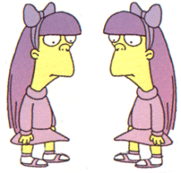

Key Constraints: Examples
Many-to-many: Entities in A and B are associated with any number from each other.
Since
name
name
Is
Classmate
of
Girls
Boys
Is Classmate of

Slide 15
Key Constraints
The arrow positioning is simple but it will help to do some examples. Think of the arrow head as pointing to the entity that “one” refers to.
Some books use 1:1, 1:N, M:N instead of arrows.

Slide 16
Key Constraints
since
name
dname
ssn
lot
did
budget
Consider Works_In: An employee can work in many departments; a dept can have many employees.
Note: you can have many relationships between two entity sets. See next page for relationship Manages.
M
N
Employees
Works_In
Departments
M:N is the default if ommitted
Notes:
6

Slide 17
Key Constraints
since
name
dname
ssn
lot
did
budget
Consider Manages: An employee can manage many departments.
In contrast, each dept has at most one manager, according to the key constraint on Manages.
1
N
Employees
Manages
Departments
1-to-1
1-to Many
Many-to-1
Many-to-Many
(1:1)
(1:N)
(N:1)
(M:N)
Notes:
6

Slide 18
Participation Constraints
Does every department have a manager?
  If so, this is a participation constraint: the participation of Departments in Manages is said to be total (vs. partial).
    Every Departments entity must appear in an instance of the Manages relationship.
since
since
name
name
dname
dname
ssn
did
did
budget
lot
budget
Employees
Manages
Departments
Here, every Department must have an employee and every Employee must work in a Department.
Works_In
Note: here we use arrows
for the key constraints.
since
Notes:
8

Slide 19
Participation Constraints
since
since
name
name
dname
dname
ssn
did
did
budget
lot
budget
Employees
Manages
Departments
Works_In
D1
D1
E1
E1
since
D4
D4
D3
D3
E8
E8
E11
E11
D2
D2
E24
E24
Manages
Works_In
Notes:
8

Slide 20
More on Relations
Entities sets can be related to themselves.
We can annotate the roles played by the entities in this case. Suppose that we want to pair a mature student with a novice student...
Course #
Course #
Study
Partner
Mature
Study
Partner
Students
Students
Novice
name
name
When entities are related to themselves, it is almost always a good idea to indicate their roles.

Slide 21
Entity Attributes Revisited
What is the correct choice of attributes to represent height?
  Using two fields, one for feet the other for inches is probably the best solution if we are never going to do arithmetic on the height, and you need to report the height in a human intuitive way (dating agency).
  If we are going to do calculations on the data (i.e calculate the BMI) we would be much better off with just the height in inches. (medical records)
Feet
Inches
Inches
Team Member
Team Member

Slide 22
Entity versus Attribute
Sometimes we have to decide whether a property of the world we want to model should be an attribute of an entity, or an entity set which is related to the attribute by a relationship set.
A major advantage of the latter approach is that we can easily model the fact that a person can have multiple phones, or that a phone might be shared by several students. (attributes can not be set-valued)
Expires
Name
SID
Phone
Name
SID
Prefix
Number
Student
Can be
reached
at
Phone #
Student

Slide 23
Entity versus Attribute Cont.
A classic example of a feature that is best modeled as a an entity set which is related to the attribute by a relationship set is an address.
Very bad choice for most applications. It would make it difficult to pretty print mailing labels, it would make it difficult to test validity of the data, it would make it difficult/impossible to do queries such as “how many students live in riverside?”
SID
Name
Address
Student
Name
SID
A better choice, but it only allows a student to have one address. Many students have a two or more address (i.e. a different address during the summer months) This method cannot handle this.
Student
Num
Street
City
Name
SID
Num
Street
City
The best choice for this problem
Student
Address
Address

Slide 24
Domains Revisited
We already said…
The domain of the attribute is the set of permitted values (e.g. the telephone number must be seven positive integers).
Defining the correct domain for an attribute is an important skill.
Making a mistake at this stage can cause huge problems later on.

Slide 25
Domains Revisited Cont.
What is the correct domain for GPA?
What is the correct domain for street address?
What is the correct domain for Phone Number? (What about foreign … )
What is the correct domain for Bank Account Balance?

Slide 26
Keys
Differences between entities must be expressed in terms of attributes.
A superkey is a set of one or more attributes which, taken collectively, allow us to identify uniquely an entity in the entity set.
For example, in the entity set student; name and S.S.N. is a superkey.
Note that name alone is not, as two students could have the same name.
A superkey may contain extraneous attributes, and we are often interested in the smallest superkey. A superkey for which no subset is a superkey is called a candidate key.
Name | S.S.N
Lisa | 1272
Bart | 5592
Lisa | 7552
Sue | 3532
We can see that {Name,S.S.N} is a superkey
In this example, S.S.N. is a candidate key, as it is minimal, and uniquely identifies a students entity.
Name
S.S.N
Student

Slide 27
Keys Cont.
A primary key is a candidate key (there may be more than one) chosen by the DB designer to identify entities in an entity set.
In the example below…
  {Make,Model,Owner,State,License#,VIN#} is a superkey
  {State,License#,VIN#} is a superkey
  {Make,Model,Owner} is not a superkey
  {State,License#} is a candidate key
  {VIN#} is a candidate key
  VIN# is the logical choice for primary key
Make
Model
Owner
Auto
State
License
VIN
Make | Model | Owner | State | License # | VIN #
Ford | Focus | Mike | CA | SD123 | 34724
BMW | Z4 | Joe | CA | JOE | 55725
Ford | Escort | Sue | AZ | TD4352 | 75822
Honda | Civic | Bert | CA | 456GHf | 77924

Slide 28
Keys Cont.
The primary key is denoted in an ER diagram by underlining.
An entity that has a primary key is called a strong entity.
Make
Model
Owner
Auto
State
License
VIN
Note that a good choice of primary key is very important!
For example, it is usually much faster to search a database by the primary key, than by any other key (we will see why later).

Slide 29
Keys Cont.
An entity set that does not possess sufficient attributes to form a primary key is called a weak entity set.
In the example below there are two different sections of C++ being offered (lets say, for example, one by Dr. Smith, one by Dr. Lee).
{Name,Number} is not a superkey, and therefore course is a weak entity.
This is clearly a problem, we need some way to distinguish between different courses….
Name | Number
C++ | CS12
Java | CS11
C++ | CS12
LISP | CS15
Name
Number
Course

Slide 30
Keys Cont.
In order to be able to uniquely refer to an item in a weak entity set we must consider some (or all) of its attributes in conjunction with some strong entities primary key. The entity whose primary key is being used is called the identifying owner.
Name
PID
Name
Number
Professor
Teaches
Course
For this to work, two conditions must be met.
The weak entity set must have total participation in the relationship
The identifying owner and the weak entity must participate is a one-to-many relationship.
Name | Number
C++ | CS12
Java | CS11
C++ | CS12
LISP | CS15
Name | PID
Smith | 2345
Lee | 7356
Chan | 3571

Slide 31
ISA (`is a’) Hierarchies
name
ssn
lot
Employees
As in C++, or other PLs, attributes are inherited.
If we declare A ISA B, every A entity is also considered to be a B entity.
hours_worked
hourly_wages
ISA
contractid
Hourly_Emps
Contract_Emps
Overlap constraints: Can Joe be an Hourly_Emps as well as a Contract_Emps entity? (Allowed/disallowed)
Covering constraints: Does every Employees entity also have to be an Hourly_Emps or a Contract_Emps entity? (Yes/no)
Reasons for using ISA:
  To add descriptive attributes specific to a subclass.
  To identify entitities that participate in a relationship.
Notes:
12

Slide 32
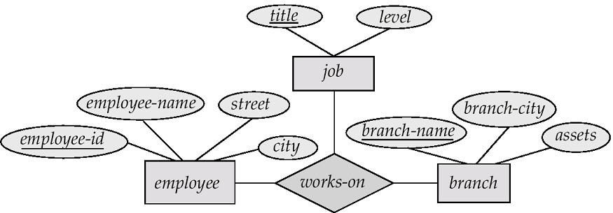
Ternary Relationships
So far, we have only considered binary relationships, however it is possible to have higher order relationships, including ternary relationships.
Consider the following example that describes the fact that employees at a bank work in one or more bank branches, and have one or more job descriptions.
Why not remove the job entity by placing the title and level attributes as part of employee?

Slide 33
Aggregation
Consider this ER model, which we have seen before…
We need to add to it, to reflect that managers manage the various tasks performed by an employee at a branch

Slide 34
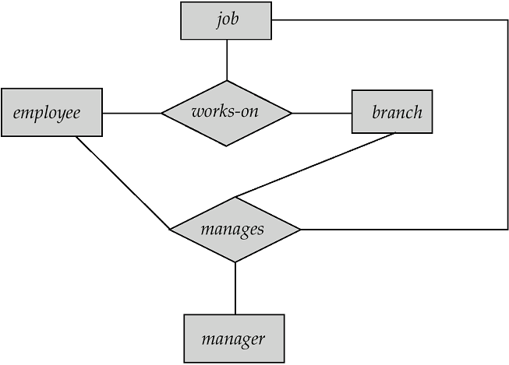
Aggregation Cont.
Note that the attributes are omitted for graphical simplicity.
Relationship sets works-on and manages represent overlapping information
Every manages relationship corresponds to a works-on relationship
However, some works-on relationships may not correspond to any manages relationships
So we can’t discard the works-on relationship

Slide 35
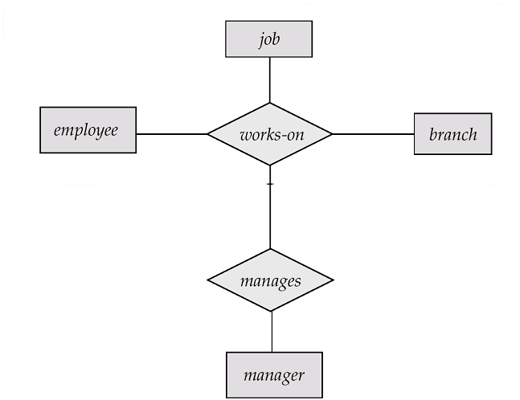
Aggregation Cont.
We can eliminate this redundancy via aggregation
  Allows relationships between relationships
  Abstraction of relationship into new entity
Without introducing redundancy, the new diagram represents:
  An employee works on a particular job at a particular branch
  An employee, branch, job combination may have an associated manager.

Slide 36
Redundancy is an enemy
Name
SSN
FemalePatient
Is_Mother?
Num_Children
What's wrong with this ER Model?

Slide 37
ER Design Decisions
The use of an attribute or entity set to represent an object.
Whether a real-world concept is best expressed by an entity set or a relationship set.
The use of a ternary relationship versus a pair of binary relationships.
The use of a strong or weak entity set.
The use of aggregation – can treat the aggregate entity set as a single unit without concern for the details of its internal structure.

Slide 38
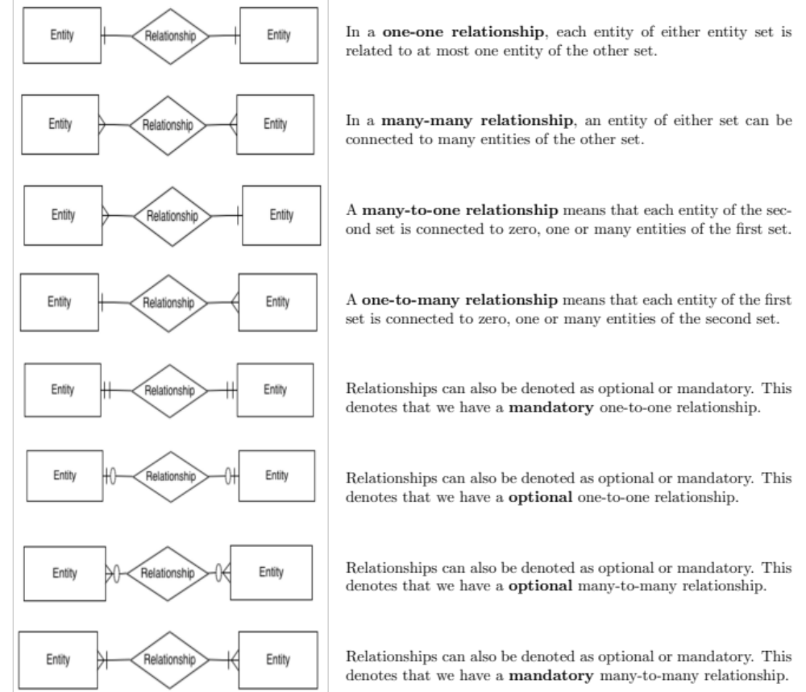

Note: it can be mandatory on one
side and not on the other.

Slide 39
Next Time
How to convert an ER diagram into a relational database, and introduction to relational algebra.
Study Suggestion
It is tempting to think you understand the many concepts introduced here because you understand the examples. To fully understand reinforce your understanding, you should try to come up with several more examples of each concept.
  Think up 3 examples of a many to one relationship
  Think up 3 examples of a weak entity set.
  Think up 3 examples of a …

